Slide 1





Social Media Insights
01 Jan 26
31 Jan 26
-
Intotum Fashion
intotum_fashion
Intotum

Slide 2



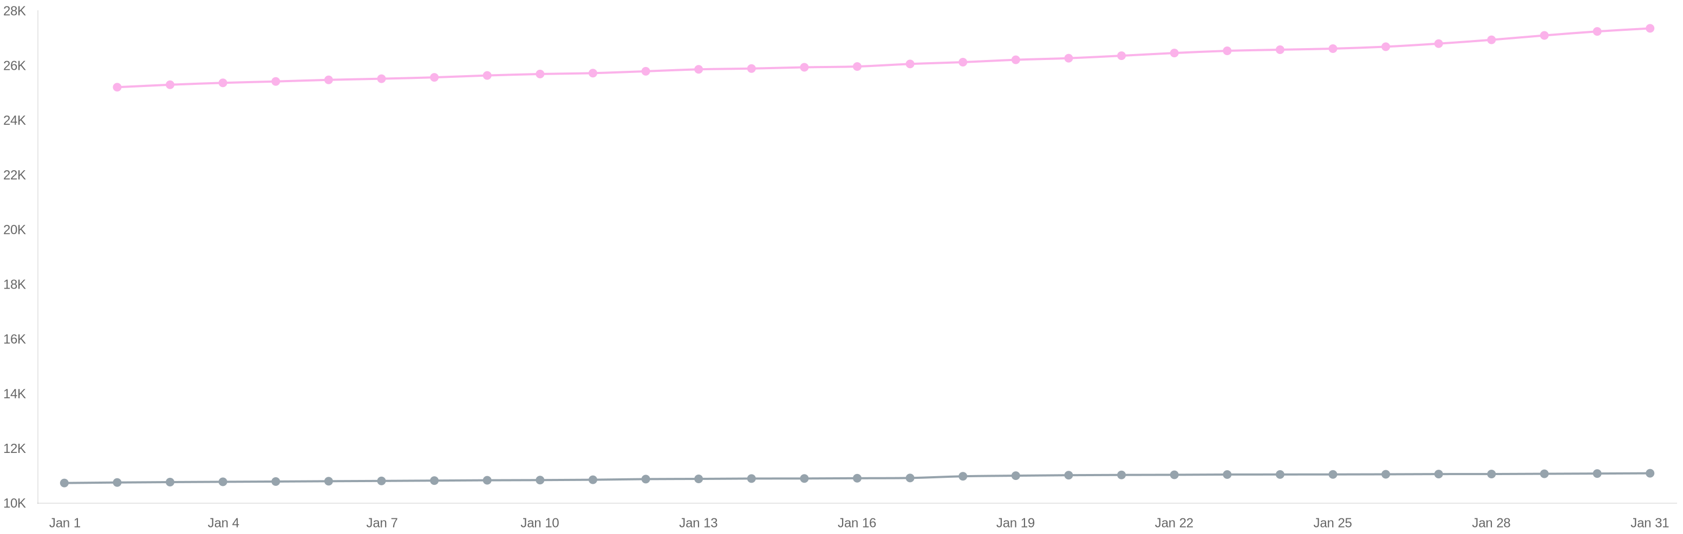
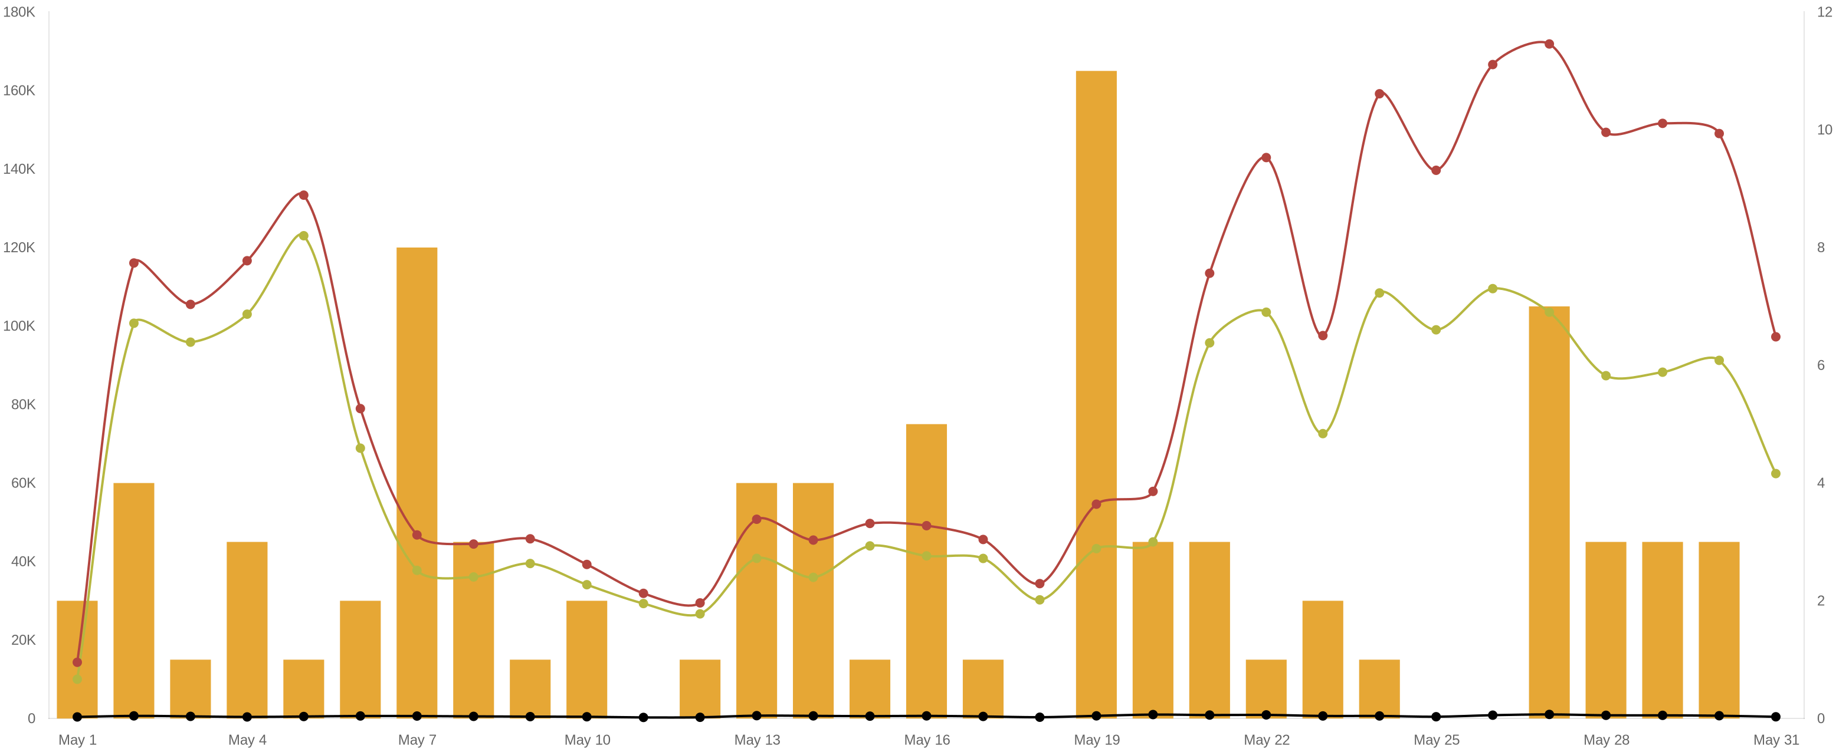



38.47K
Followers
intotum_fashion
27.37K
11.10K
Instagram
Tiktok
01 Jan 26
31 Jan 26
-

Slide 3

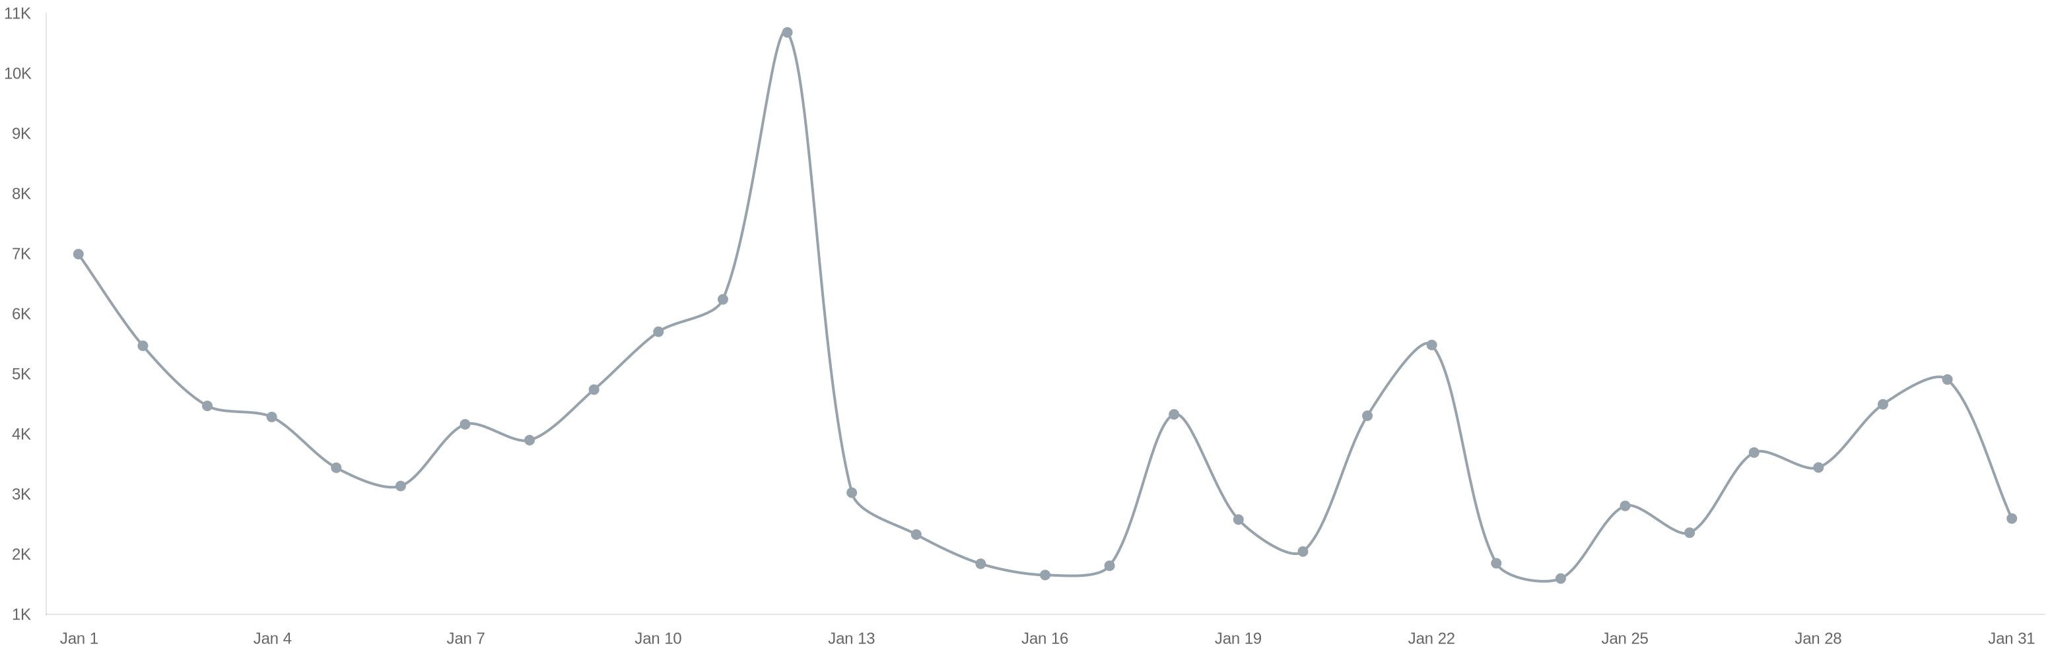
120.43K
-57.87%
Impressions
intotum_fashion
120.43K
-57.87%
Tiktok
01 Jan 26
31 Jan 26
-

Slide 4

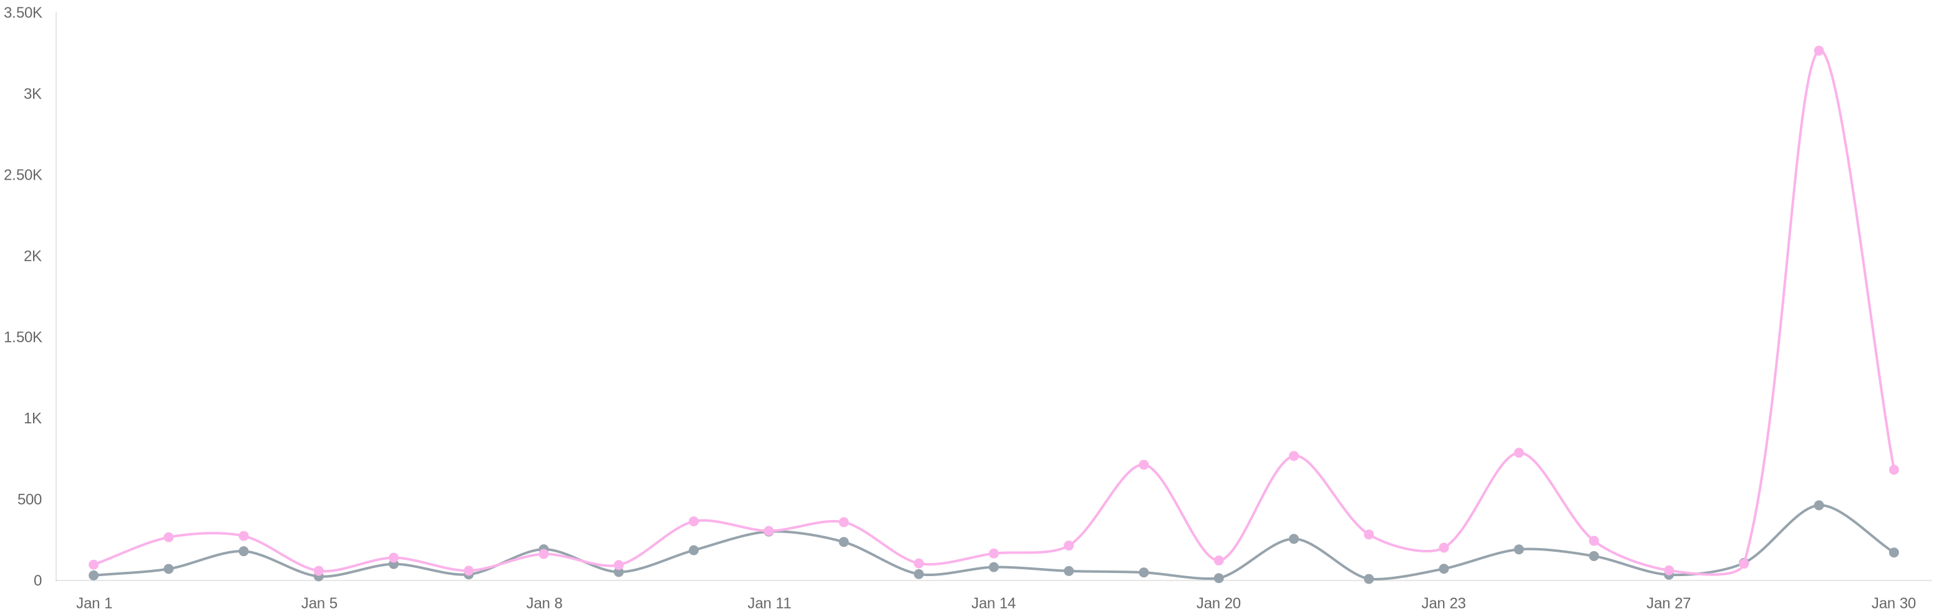
13.06K
-87.98%
Interactions
intotum_fashion
9924
-89.92%
3136
-69.32%
Instagram
Tiktok
01 Jan 26
31 Jan 26
-

Slide 5

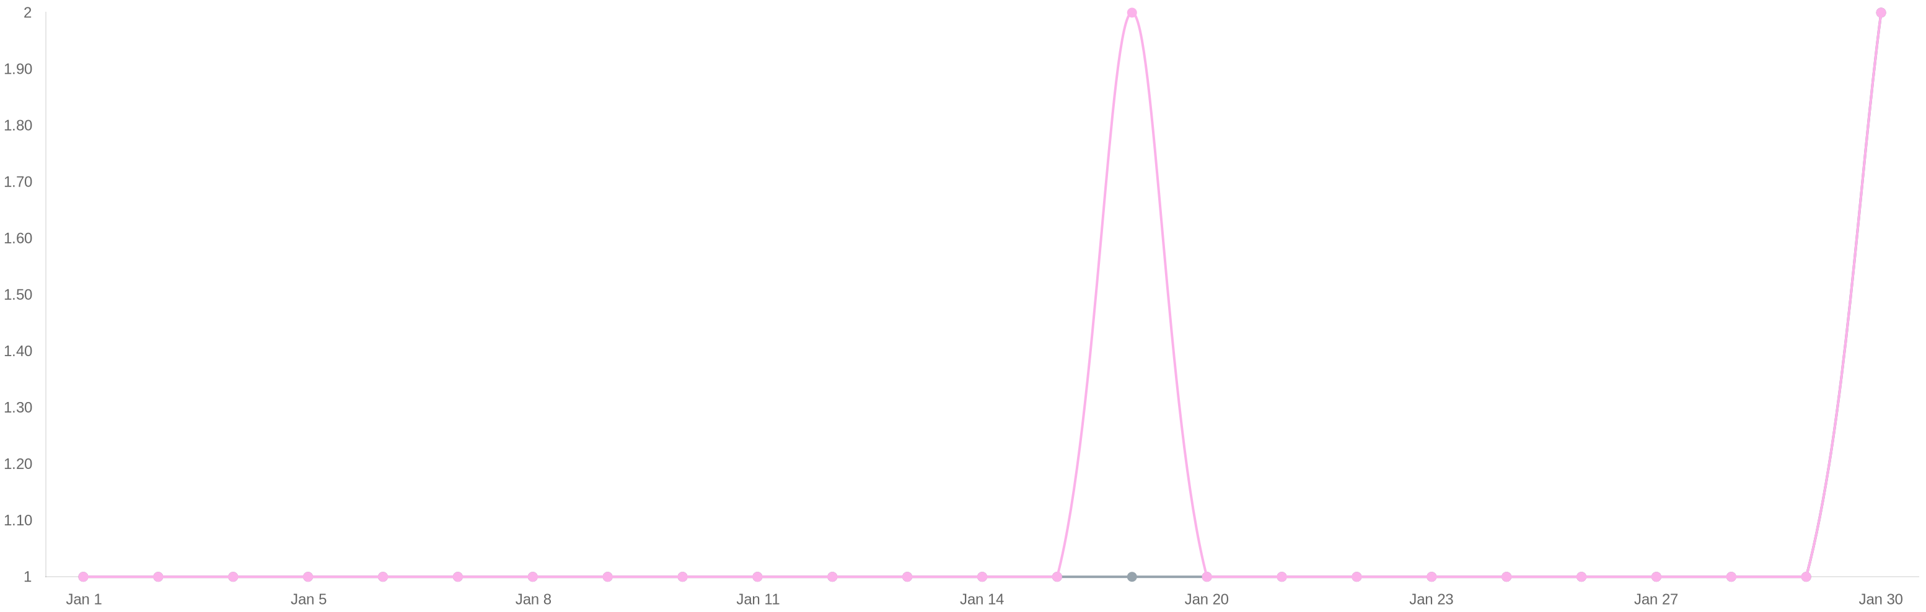
53
+35.90%
Posts
intotum_fashion
27
+12.50%
26
+73.33%
Instagram
Tiktok
01 Jan 26
31 Jan 26
-

Slide 6


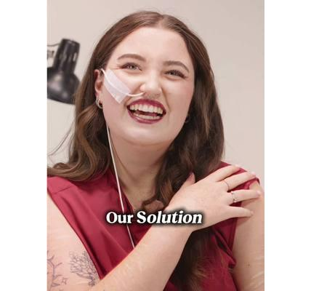
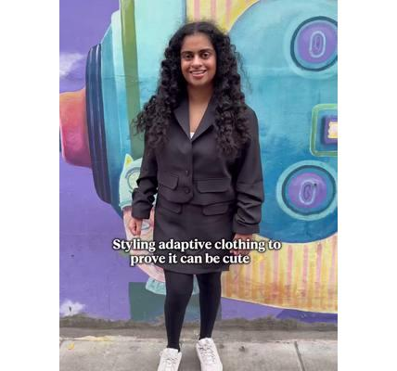
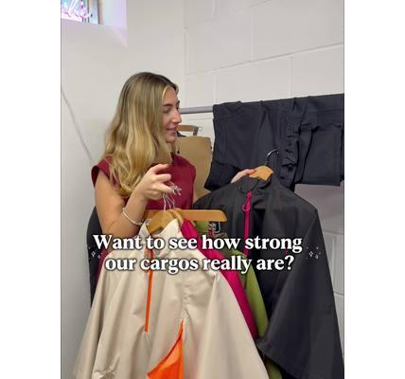



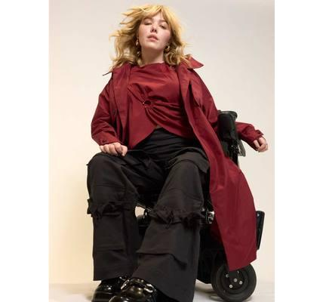
Ranking of posts
intotum_fashion
Showing 20 posts sorted by social network
Published |  | Type | Text |  |  | Impressions | Interactions
Jan 30, 2026 8:45 PM |  |  | Can finally share the news! 😮 Becoming a member of the British Fashion Council has always been an a... | Go |  | 1038 | 126
Jan 30, 2026 8:39 PM |  |  | This honestly feels surreal. From being told adaptive fashion was “too niche” and “not real fashion”... | Go |  | 423 | 47
Jan 29, 2026 8:04 PM |  |  | ❌ The problem Getting dressed should not be a daily struggle. Traditional clothing is built for stan... | Go |  | 5605 | 464
Jan 28, 2026 10:39 PM |  |  | It should never be a choice between comfort and style. You deserve both. Always. We get it, other ad... | Go |  | 1267 | 109
Jan 27, 2026 8:36 PM |  |  | This little feature carries more than you think 👀 We put our hoist bands through real testing becau... | Go |  | 849 | 36
Jan 26, 2026 9:14 PM |  |  | Serena & Blair vibes only 🫶 Tag below who you would twin with in these stunning coats 👇 #intotumfa... | Go |  | 2162 | 151
01 Jan 26
31 Jan 26
-

Slide 7
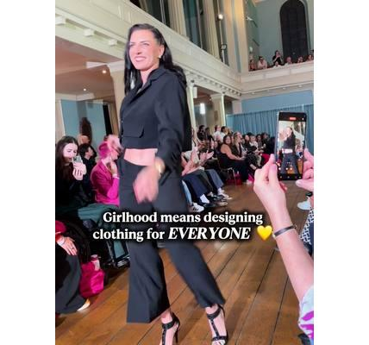
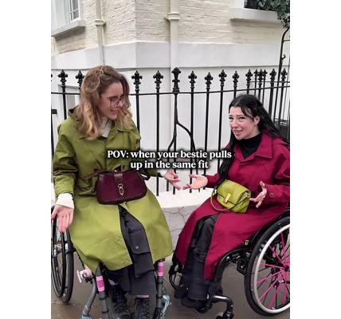
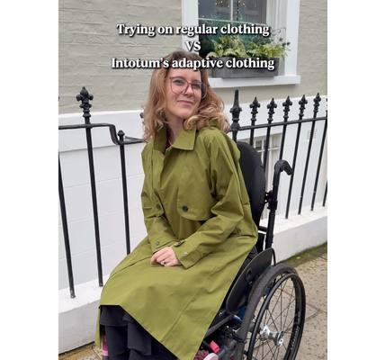
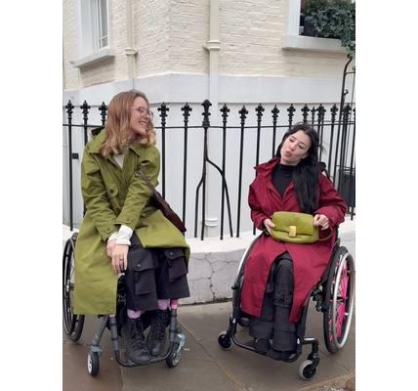
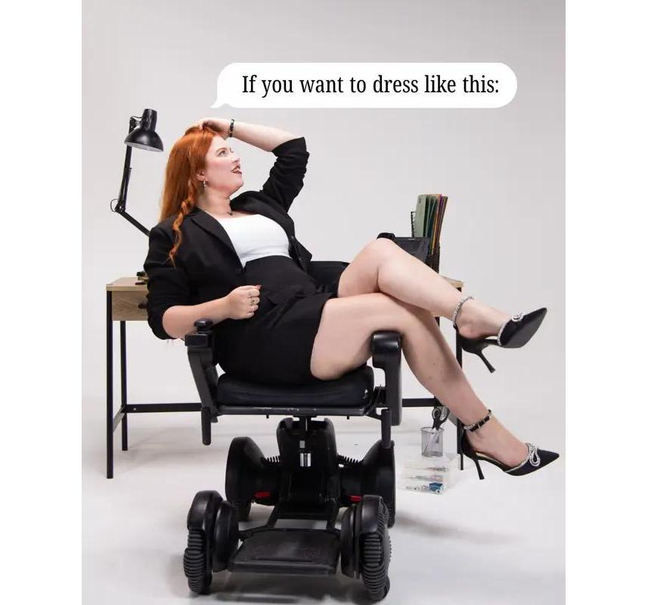
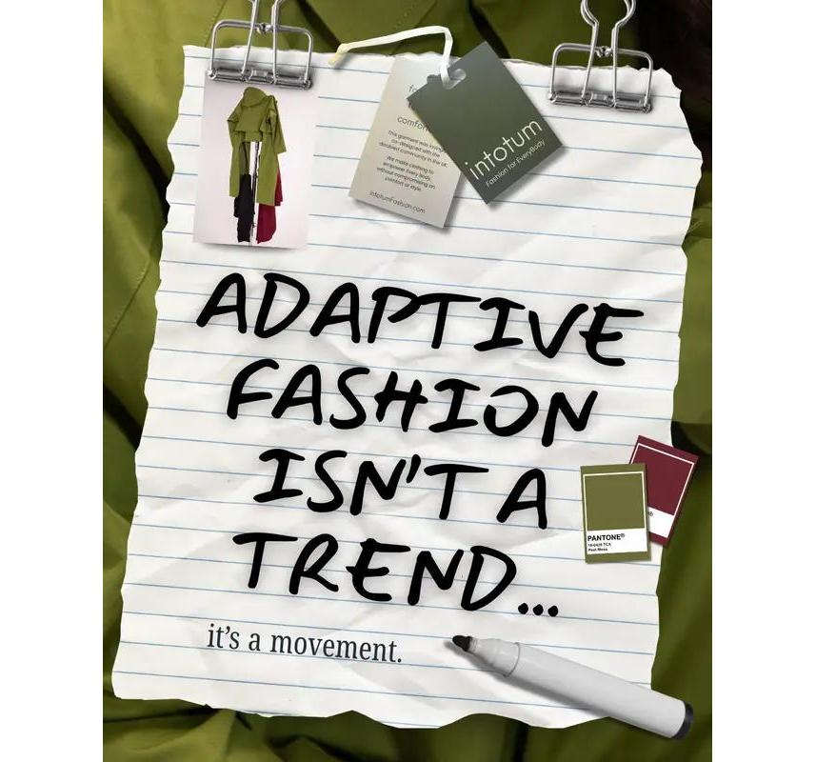
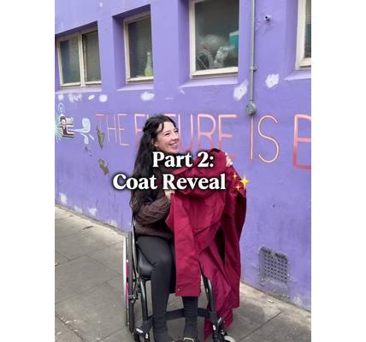
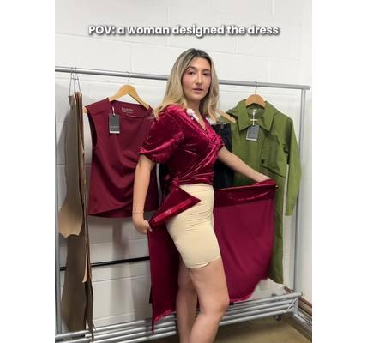
Published |  | Type | Text |  |  | Impressions | Interactions
Jan 25, 2026 7:33 PM |  |  | It’s the details that count 🥰 #intotum #adaptivefashion #adaptiveclothing #AdaptiveDress #DisabledF... | Go |  | 2950 | 192
Jan 23, 2026 8:35 PM |  |  | Girlhood means designing clothes for everyone. Fun to wear. Easy to love. Made to fit real people. #... | Go |  | 576 | 73
Jan 22, 2026 9:01 PM |  |  | Should’ve texted the group chat 👀 Tag the friend you always end up twinning with without trying! #i... | Go |  | 148 | 10
Jan 21, 2026 8:36 PM |  |  | Trying on regular clothes vs Intotum adaptive clothing… it’s honestly a game changer 👀 Trying to sq... | Go |  | 7830 | 257
Jan 20, 2026 8:50 PM |  |  | When the fit is so good that you and your bestie need to get all the angles… ✨🫶 #intotumfashion #fi... | Go |  | 184 | 15
Jan 19, 2026 9:25 PM |  |  | Wanna wear adaptive fashion that actually looks this good? Say less 👀 You shouldn’t have to dig thr... | Go |  | 759 | 50
Jan 15, 2026 10:15 PM |  |  | Adaptive design means thinking about comfort, ease, style and access all at once. And that should ne... | Go |  | 799 | 59
Jan 14, 2026 8:07 PM |  |  | Her reaction said it all 💛 She finally got to try the adaptive coat she had been dreaming about! If... | Go |  | 995 | 83
01 Jan 26
31 Jan 26
-

Slide 8
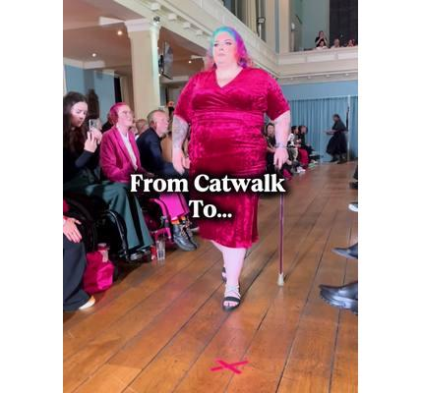
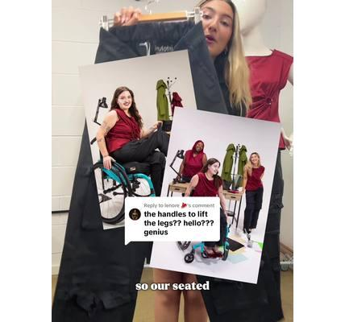
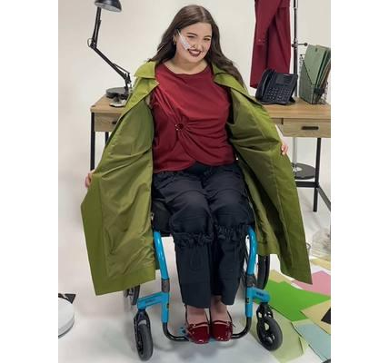

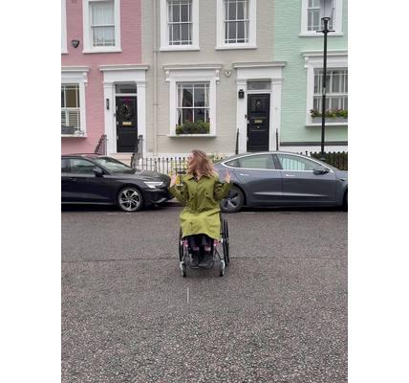
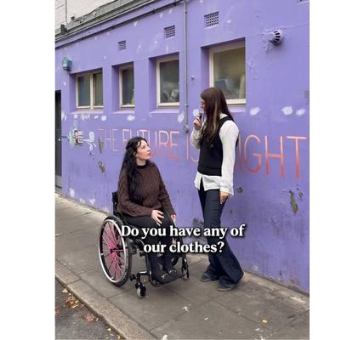
Published |  | Type | Text |  |  | Impressions | Interactions
Jan 13, 2026 9:39 PM |  |  | We hit the streets to ask if anyone had heard of Intotum Fashion 👀🫶 We love turning wishlists into... | Go |  | 608 | 40
Jan 12, 2026 7:40 PM |  |  | Off the runway and into real life with this stunning piece 🫶 The velvet wrap dress gives you that d... | Go |  | 7010 | 238
Jan 11, 2026 9:41 PM |  |  | Replying to @lenore 🥩 Our “genius” trousers are not only the comfiest trousers you will ever wear, ... | Go |  | 2353 | 302
Jan 10, 2026 7:43 PM |  |  | That doesn’t mean just adding zips or lazy designs… it means stylish functional clothing built to la... | Go |  | 2075 | 187
Jan 9, 2026 7:35 PM |  |  | A quick fire Q&A with the gorgeous @feyas_world in the velvet wrap dress and she looked unreal 💛 Th... | Go |  | 771 | 53
Jan 8, 2026 8:03 PM |  |  | I’ve got my girls and we feel so good in our fits 💛 Different needs, different bodies, but the same... | Go |  | 2815 | 193
01 Jan 26
31 Jan 26
-

Slide 9
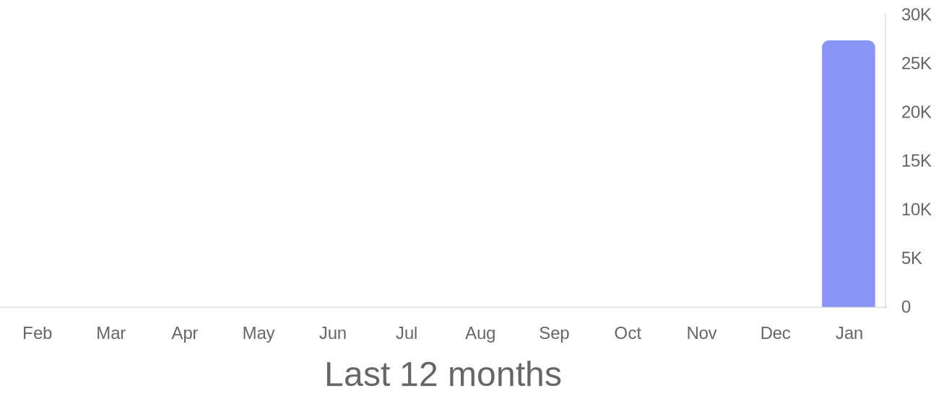
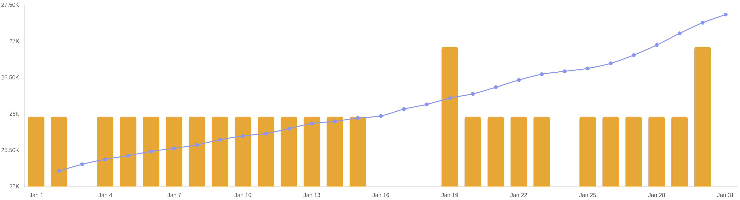
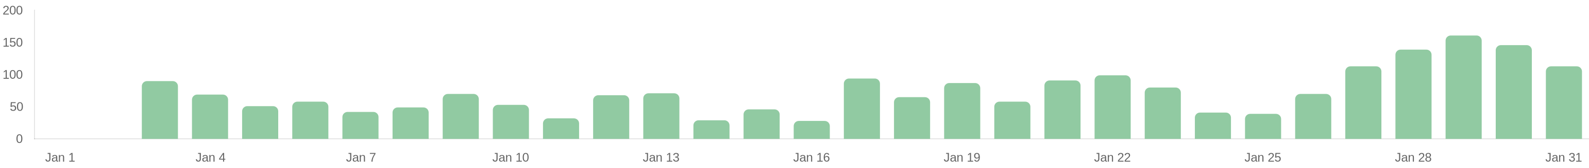
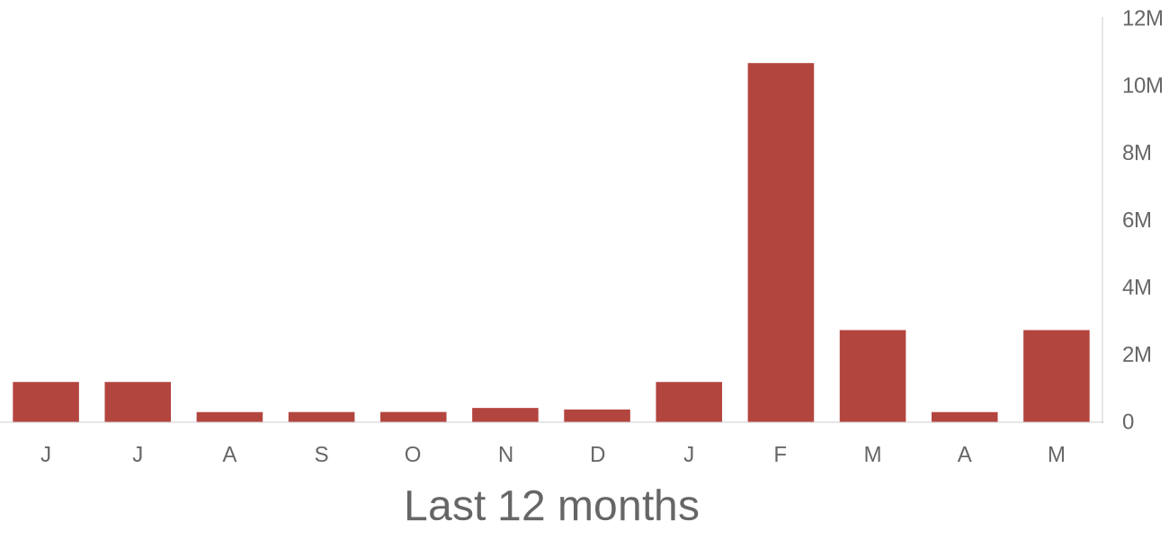
Community growth
intotum_fashion
27.37K
2152
27
+12.50%
Followers
Followers balance
Total content
01 Jan 26
31 Jan 26
-

Slide 10
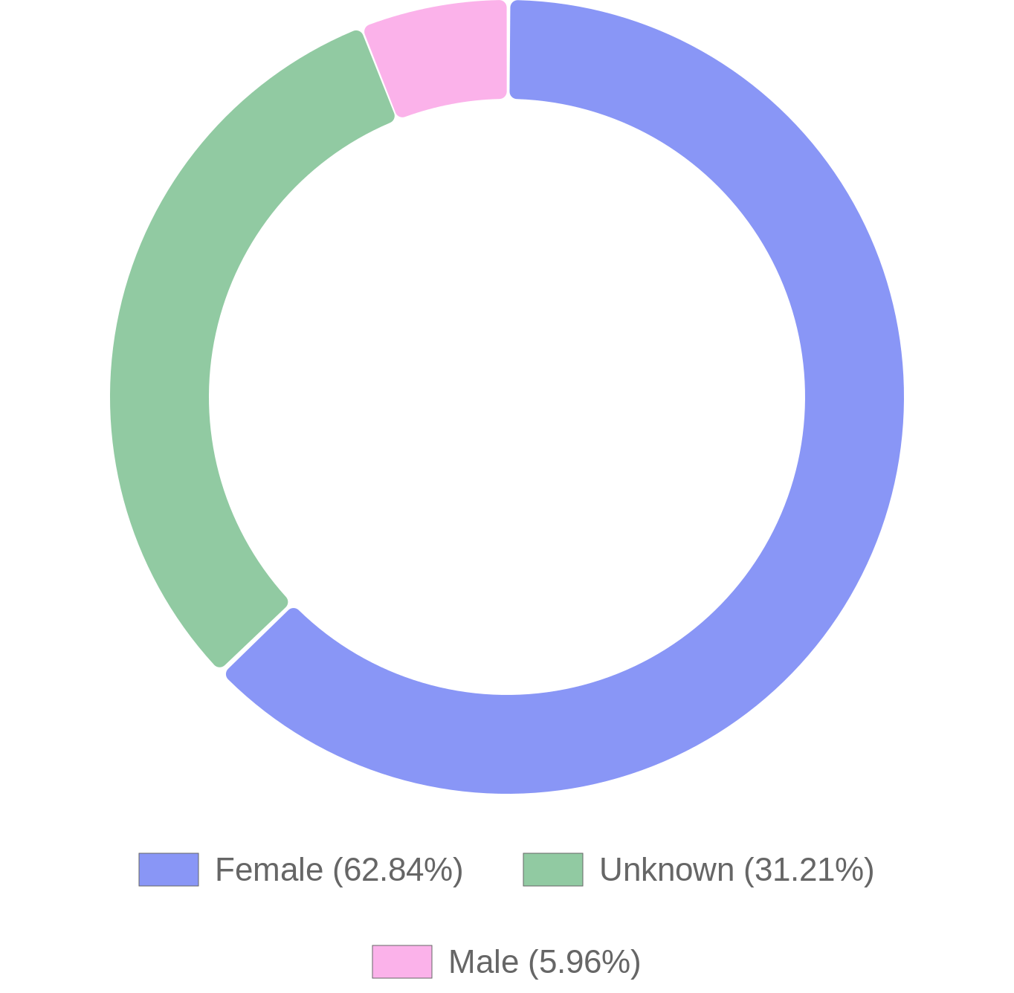
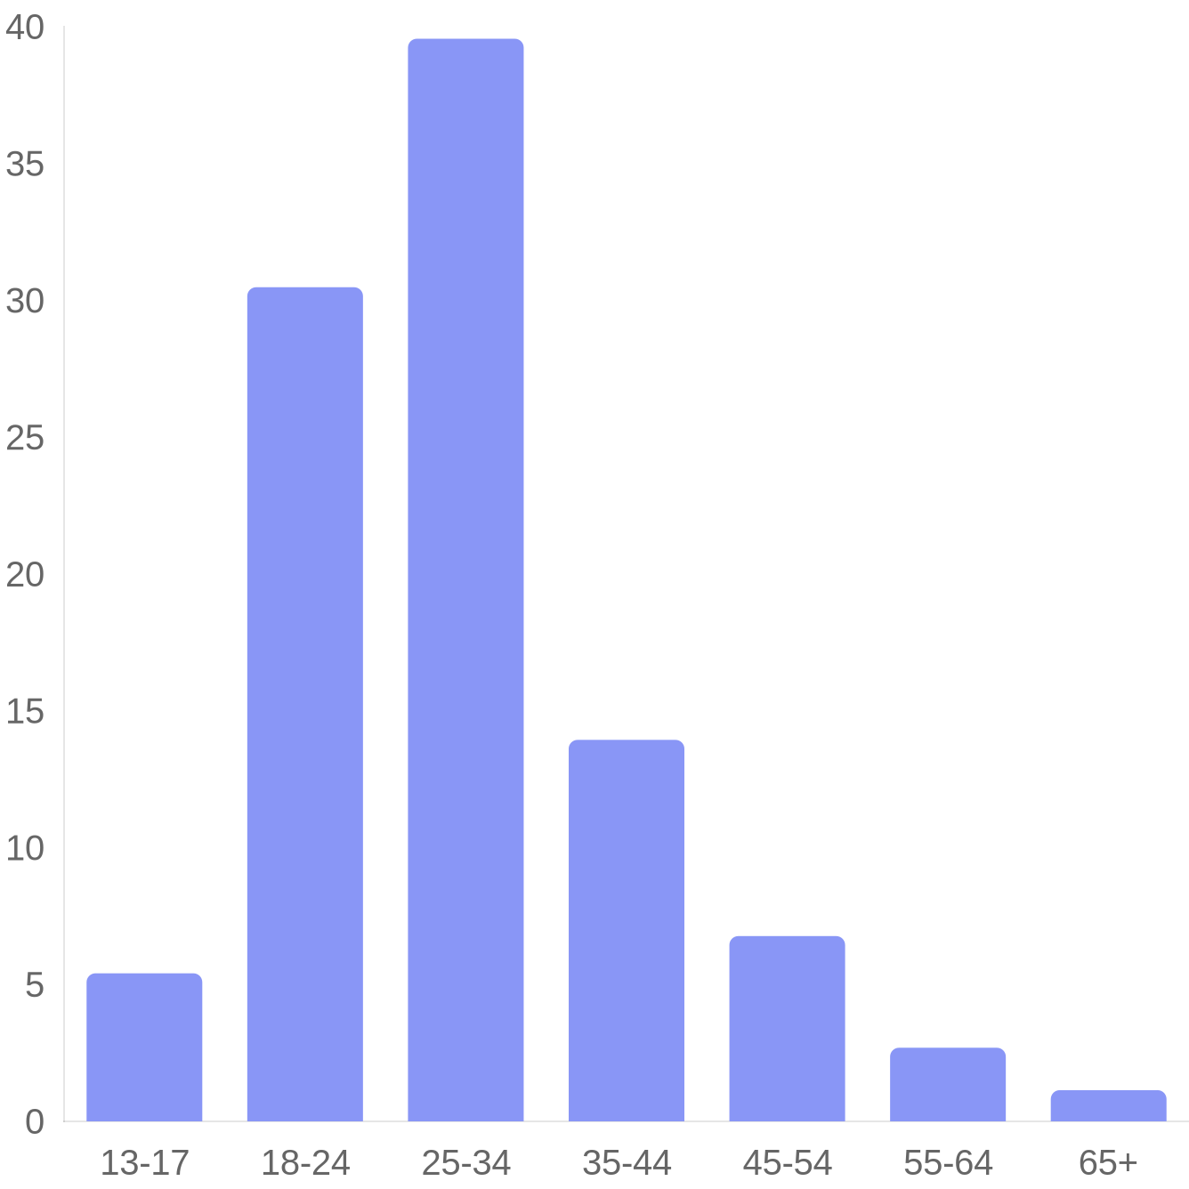
Demographics: gender and age
intotum_fashion
Gender
Ages
01 Jan 26
31 Jan 26
-

Slide 11
Demographics: countries and cities
intotum_fashion
Top 10 countries
Top 10 cities
United States | 29.42%
United Kingdom | 20.59%
Canada | 5.14%
Australia | 4.72%
Brazil | 4.61%
Germany | 4.54%
France | 4.29%
Mexico | 2.55%
Spain | 1.95%
Italy | 1.93%
London, England | 3.05%
Melbourne, Victoria | 1.15%
New York, New York | 0.96%
São Paulo, São Paulo (state) | 0.72%
Santiago, Santiago Metropolitan Region | 0.70%
Sydney, New South Wales | 0.64%
Mexico City, Distrito Federal | 0.61%
Toronto, Ontario | 0.55%
Berlin, Berlin | 0.49%
Los Angeles, California | 0.46%
01 Jan 26
31 Jan 26
-

Slide 12
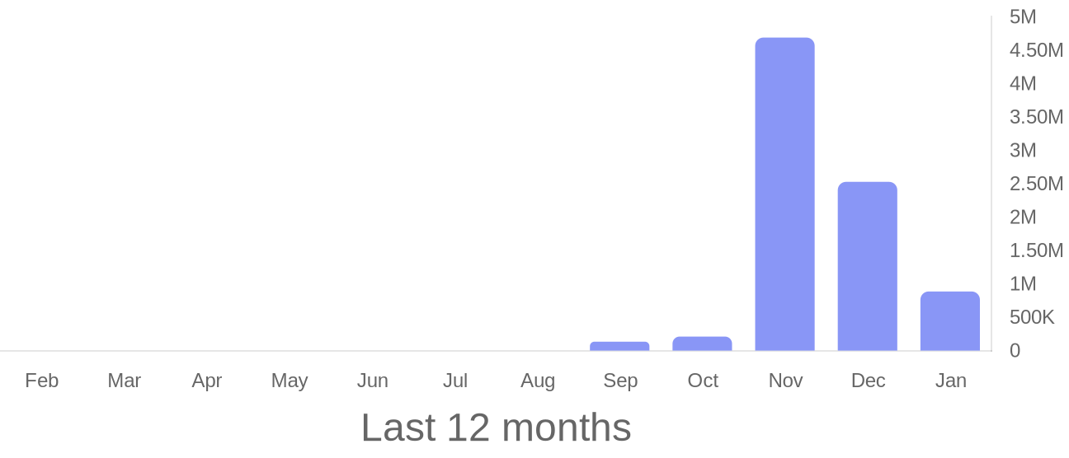
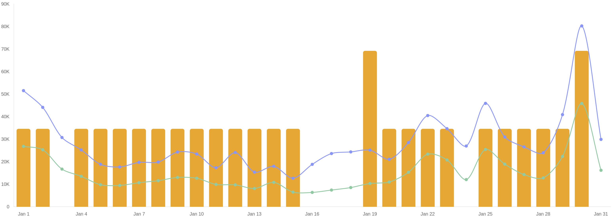
Average reach per day
intotum_fashion
885.43K
-64.97%
15.04K
-66.33%
27
+12.50%
Views
Average reach per day
Total content
01 Jan 26
31 Jan 26
-

Slide 13
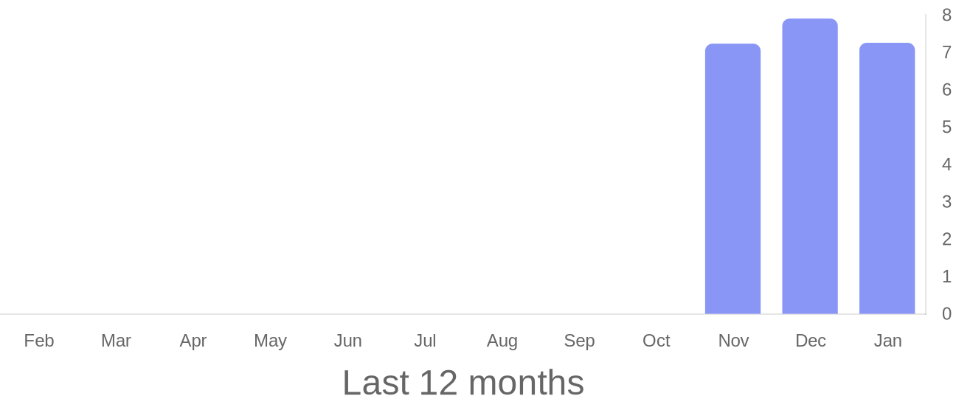
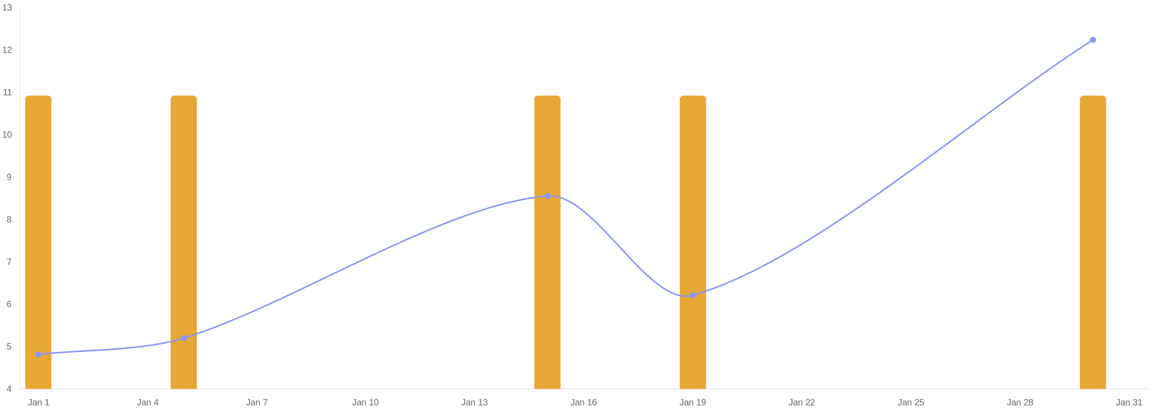
Posts published in period
intotum_fashion
7.26
-8.19%
5
-44.44%
Engagement
Posts
01 Jan 26
31 Jan 26
-

Slide 14
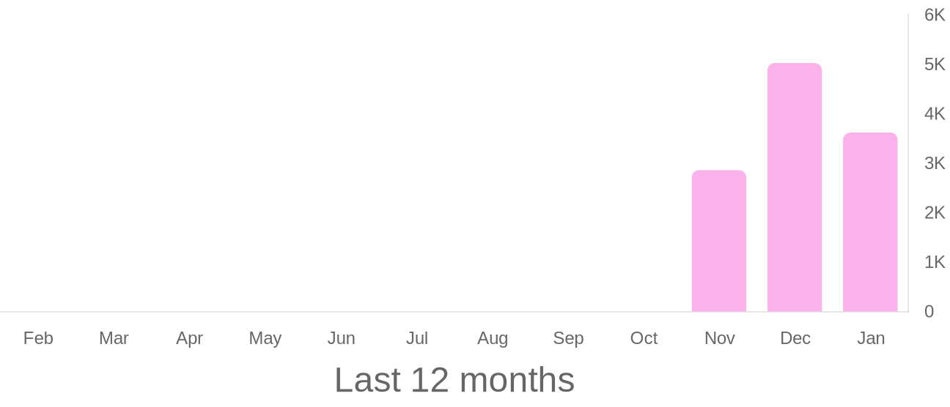
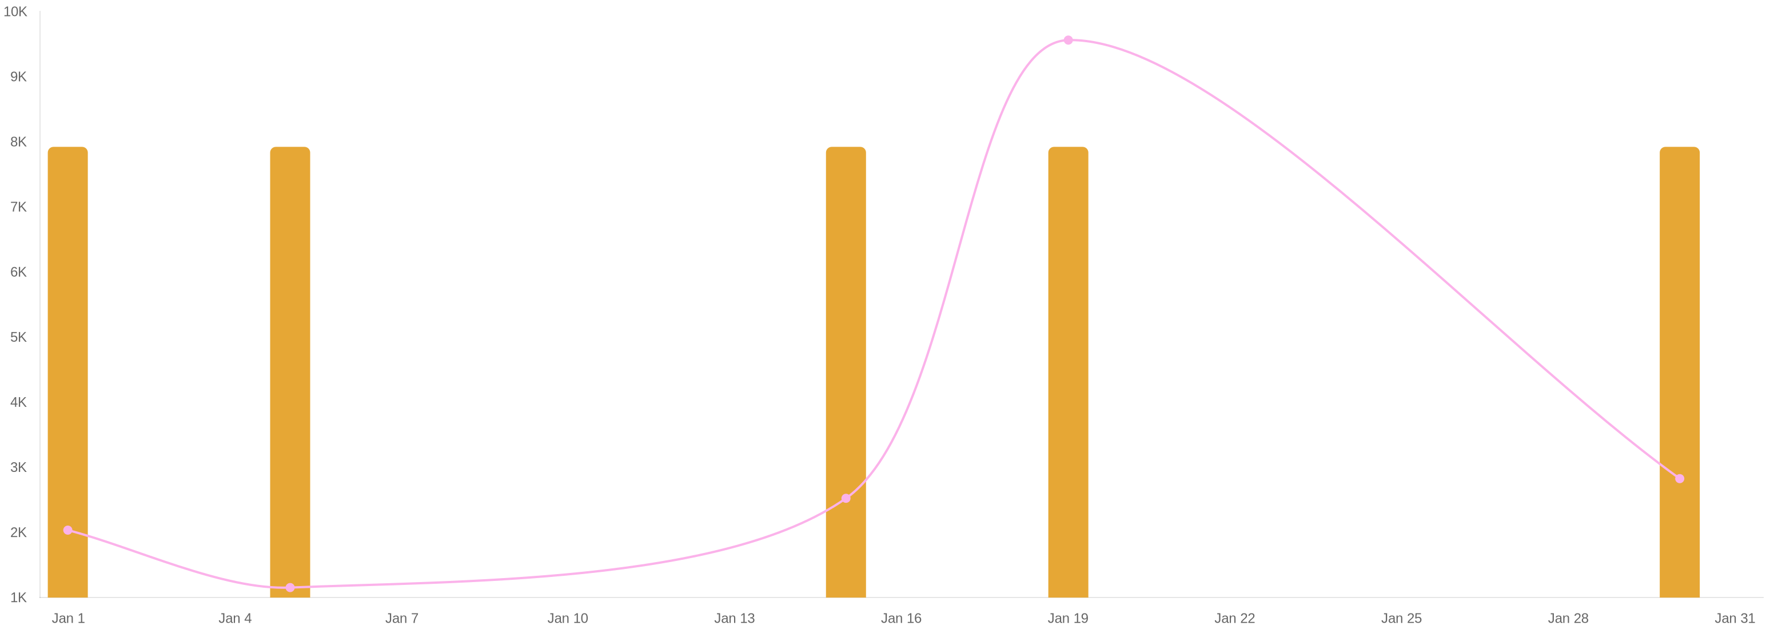
Reach of published posts
intotum_fashion
3621
-27.96%
5
-44.44%
Avg reach per post
Posts
01 Jan 26
31 Jan 26
-

Slide 15
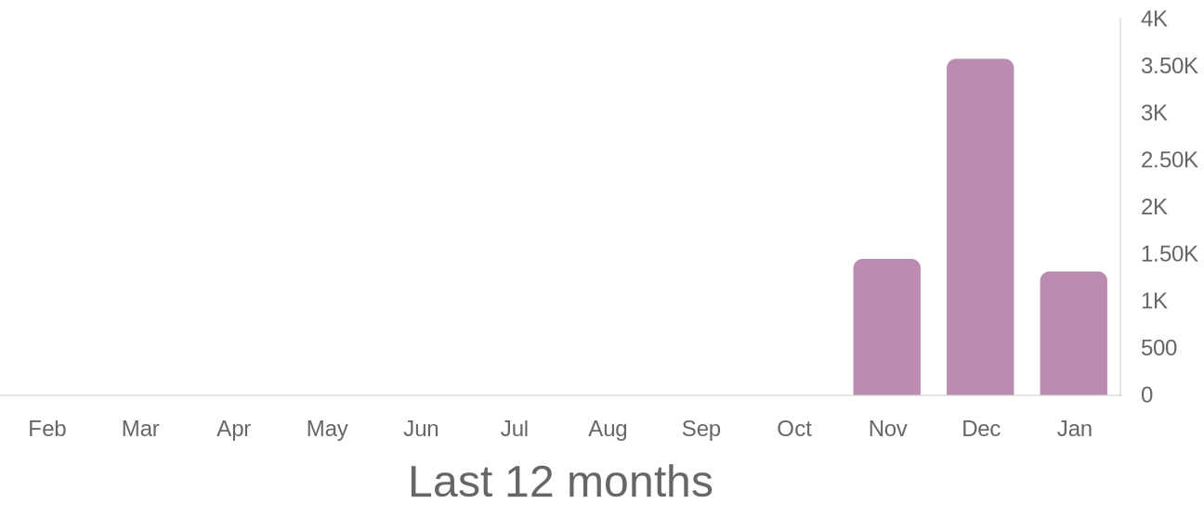
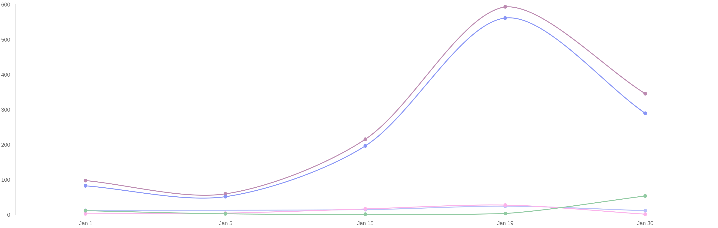
Interactions of published posts
intotum_fashion
1184
-63.65%
75
-38.02%
55
-72.22%
65
-84.78%
Likes
Comments
Saved
Shares
1314
-63.26%
Interactions
01 Jan 26
31 Jan 26
-

Slide 16


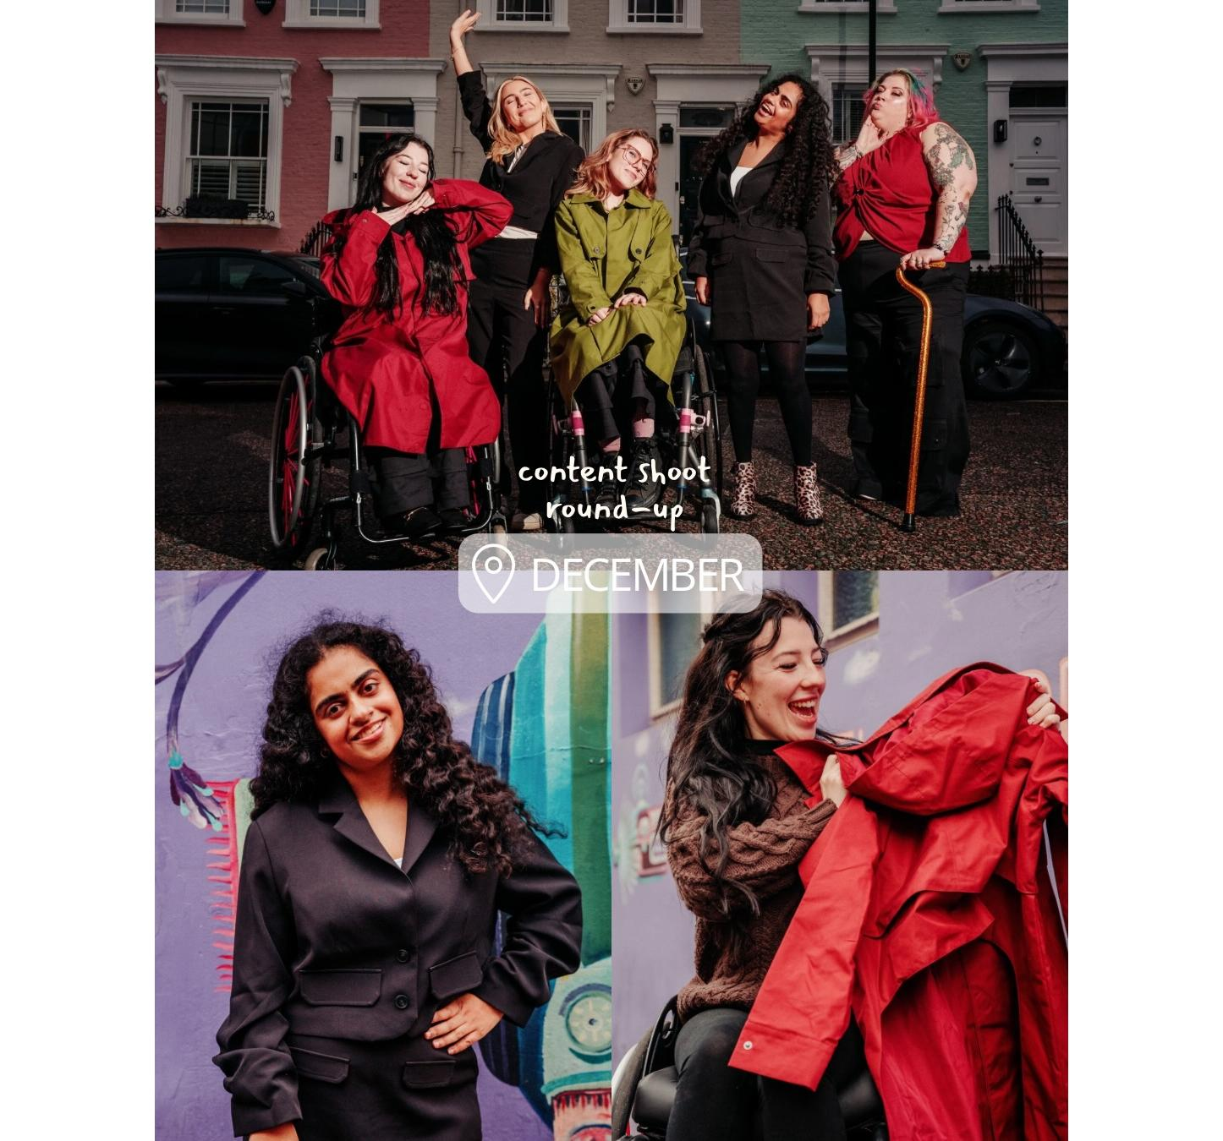
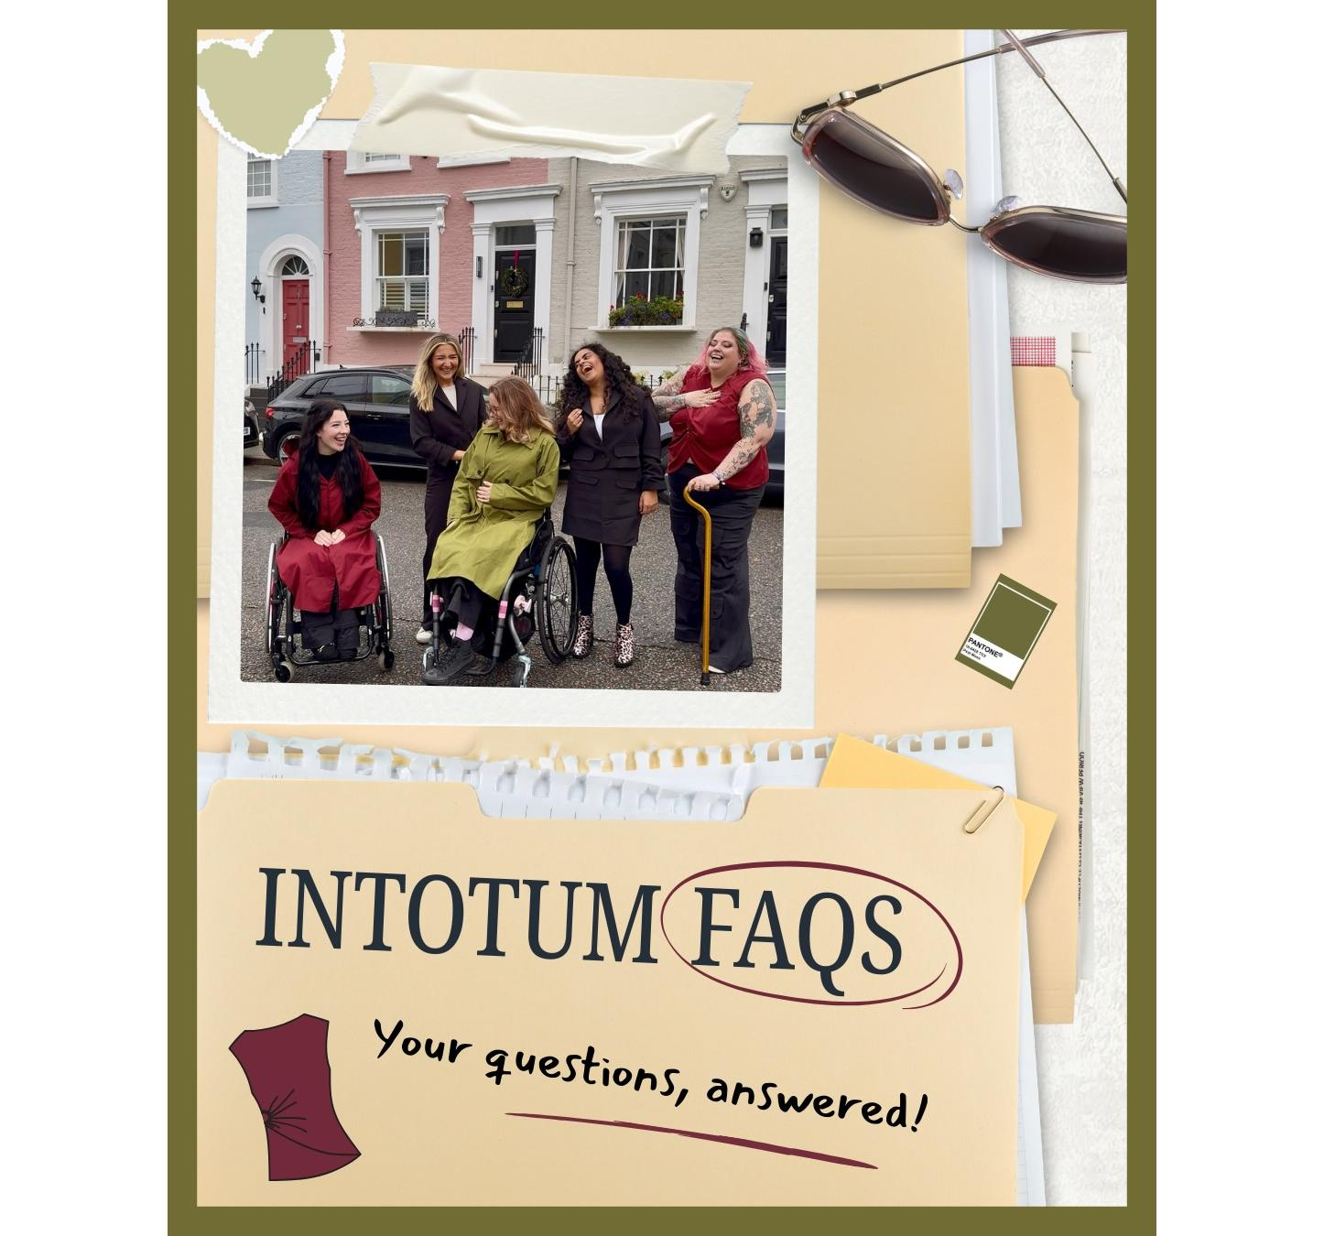

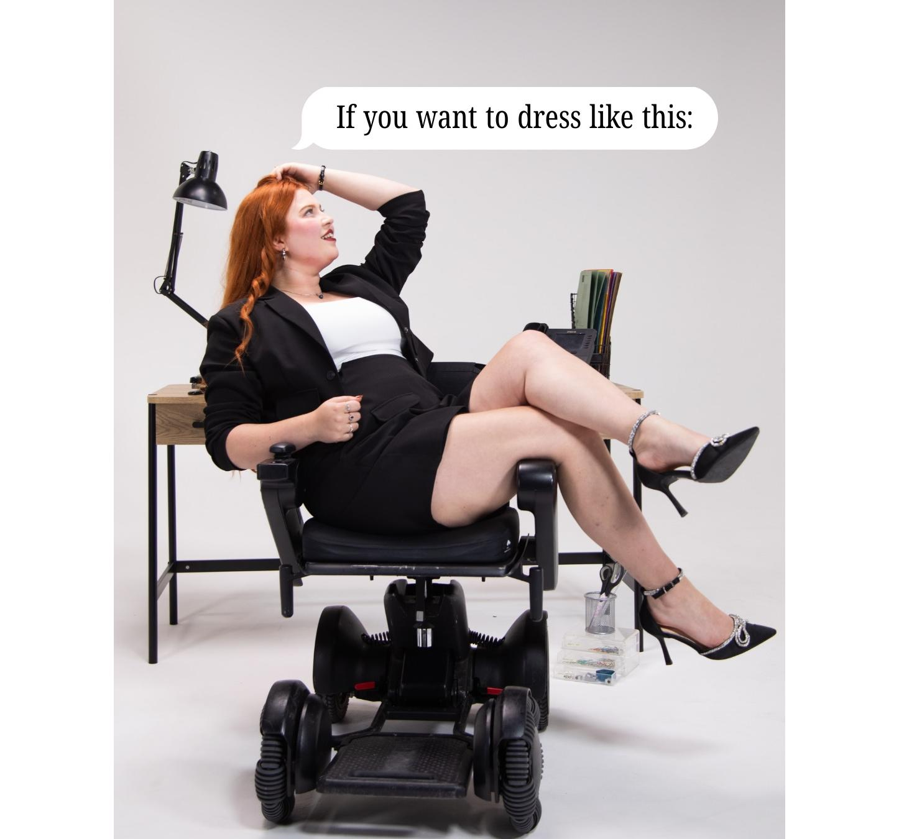
Ranking of posts
intotum_fashion
Showing 5 posts sorted by views
Published |  | Type | Text |  | Views | Reach | Likes | Comments | Saved | Engagement
Jan 19, 2026 8:20 PM |  |  | Wanna wear adaptive fashion that actually looks th... | Go | 16.49k | 9563 | 562 | 4 | 28 | 6.47
Jan 30, 2026 7:28 PM |  |  | Intotum is now an official member of the British F... | Go | 6778 | 2827 | 290 | 54 | 2 | 12.66
Jan 15, 2026 7:51 PM |  |  | Adaptive design means thinking about comfort, ease... | Go | 4622 | 2525 | 197 | 2 | 17 | 9.15
Jan 1, 2026 10:01 PM |  |  | Content day recap because this one meant a lot 🤭?... | Go | 4607 | 2036 | 83 | 12 | 3 | 5.45
Jan 5, 2026 8:13 PM |  |  | Let’s break it down with an Intotum FAQs moment 🫶... | Go | 2927 | 1154 | 52 | 3 | 5 | 5.2
01 Jan 26
31 Jan 26
-

Slide 17
Ranking of hashtags
intotum_fashion
Showing 16 hashtags sorted by views
 | Posts | Views | Likes | Comments
#inclusiveclothing | 1 | 16.49k | 562 | 4
#cutefitsonly | 1 | 16.49k | 562 | 4
#adaptivefashion | 4 | 8124 | 283 | 18
#madeforyou | 4 | 7161 | 223 | 5
#intotumfashion | 4 | 7161 | 223 | 5
#bfc | 1 | 6778 | 290 | 54
#britishfashioncouncil | 1 | 6778 | 290 | 54
#adaptive | 1 | 6778 | 290 | 54
#intotum | 1 | 6778 | 290 | 54
#bfcmember | 1 | 6778 | 290 | 54
01 Jan 26
31 Jan 26
-

Slide 18
 | Posts | Views | Likes | Comments
#fashionforallbodies | 1 | 4622 | 197 | 2
#inclusionmatters | 1 | 4622 | 197 | 2
#behindthescenes | 1 | 4607 | 83 | 12
#inclusivewardrobe | 2 | 3767 | 67 | 7
#faqsanswered | 1 | 2927 | 52 | 3
#adaptiveclothing | 1 | 2927 | 52 | 3
01 Jan 26
31 Jan 26
-

Slide 19
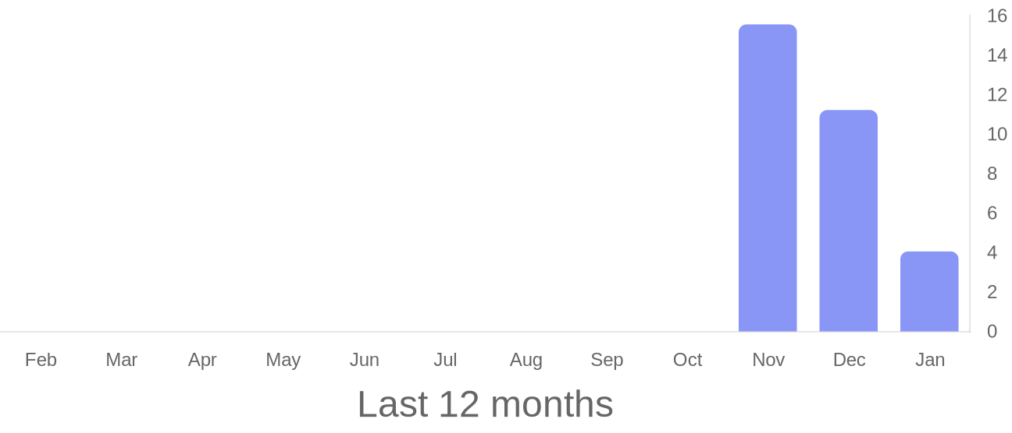
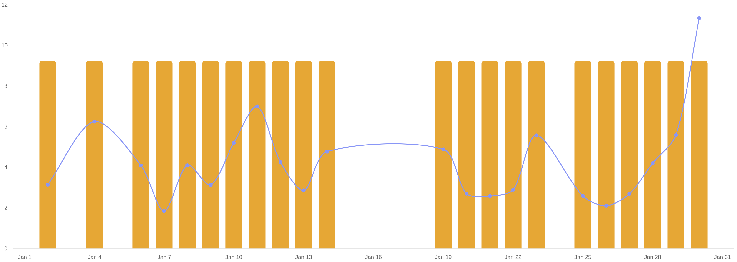
Reels published in period
intotum_fashion
4.06
-63.87%
22
+46.67%
Engagement
Reels
01 Jan 26
31 Jan 26
-

Slide 20
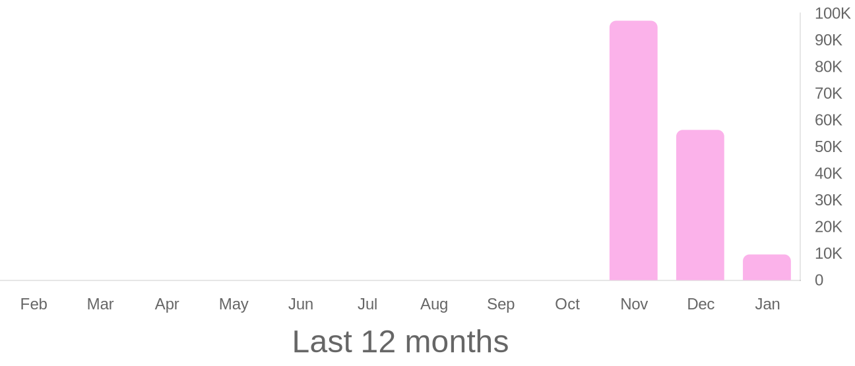
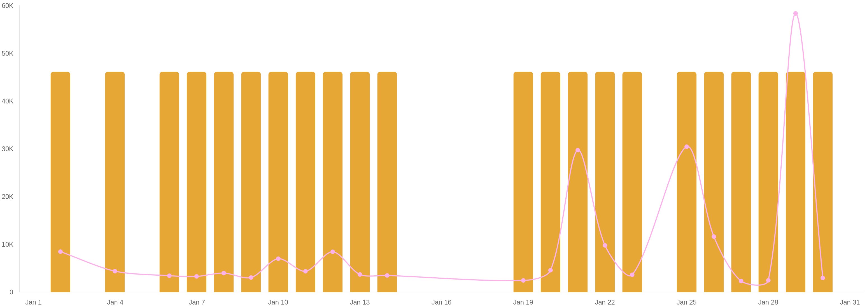
Reach of published reels
intotum_fashion
9647.09
-82.88%
22
+46.67%
Avg reach per reel
Reels
01 Jan 26
31 Jan 26
-

Slide 21
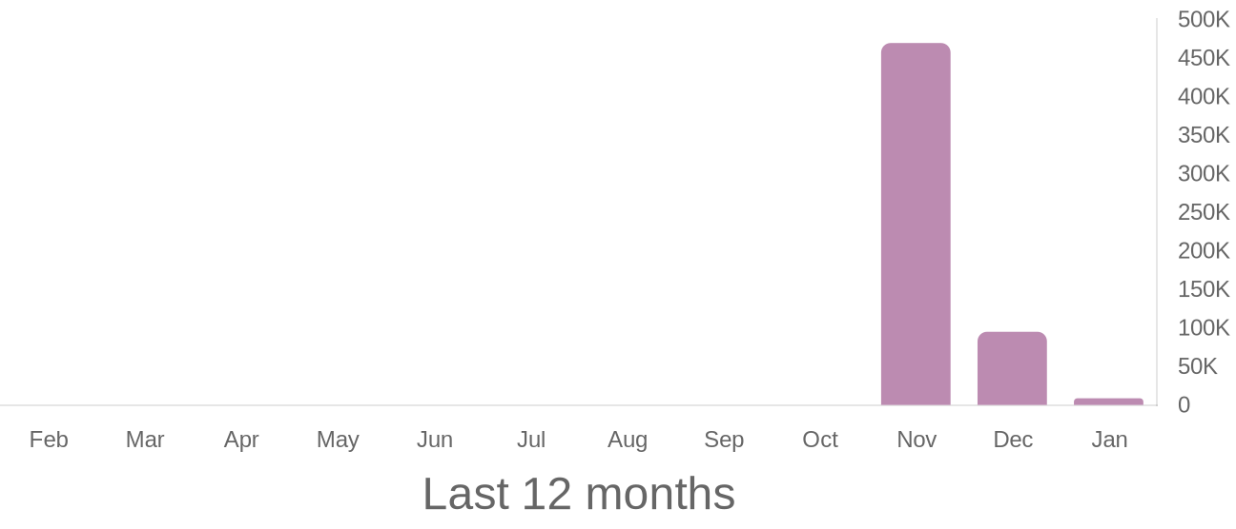
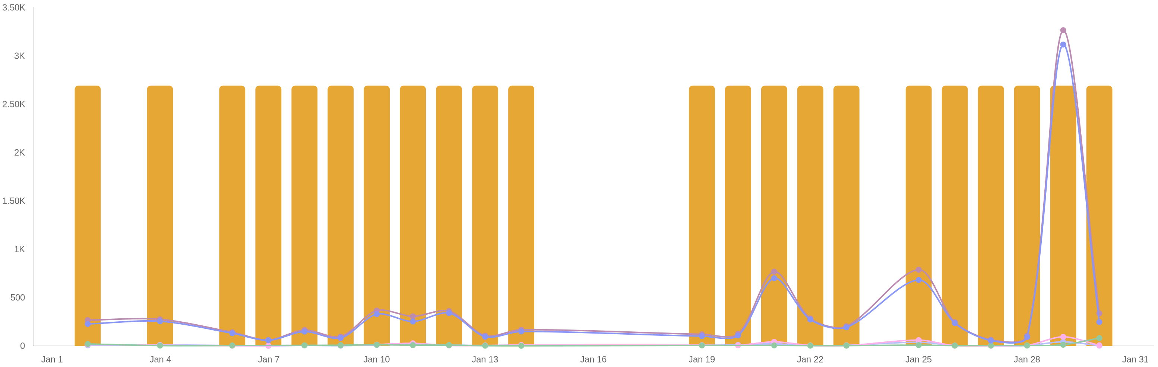
Interactions of published reels
intotum_fashion
7870
-90.95%
199
-55.97%
324
-93.35%
8610
-90.93%
Likes
Comments
Saved
Interactions
217
-91.78%
22
+46.67%
Shares
Reels
01 Jan 26
31 Jan 26
-

Slide 22
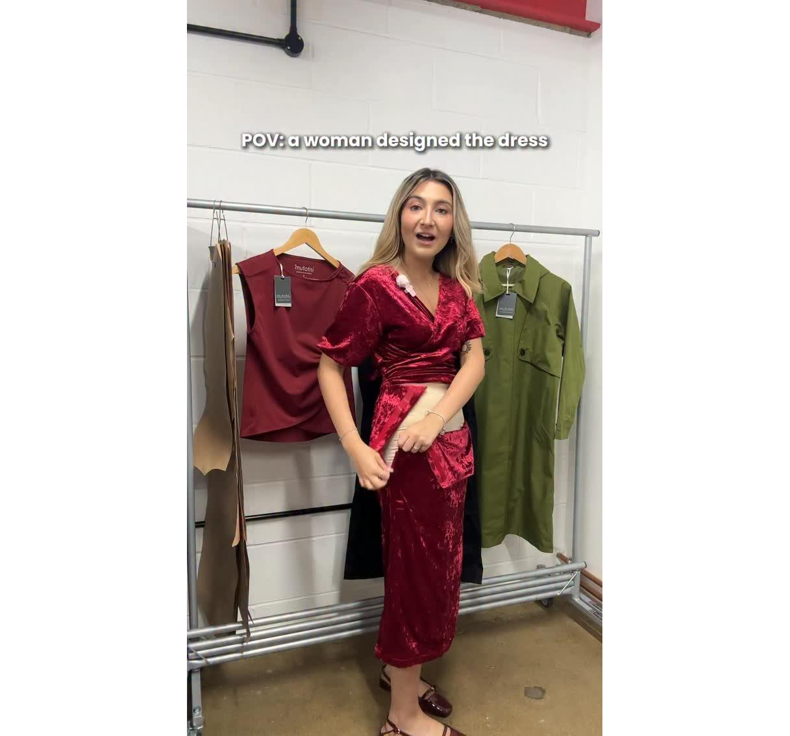

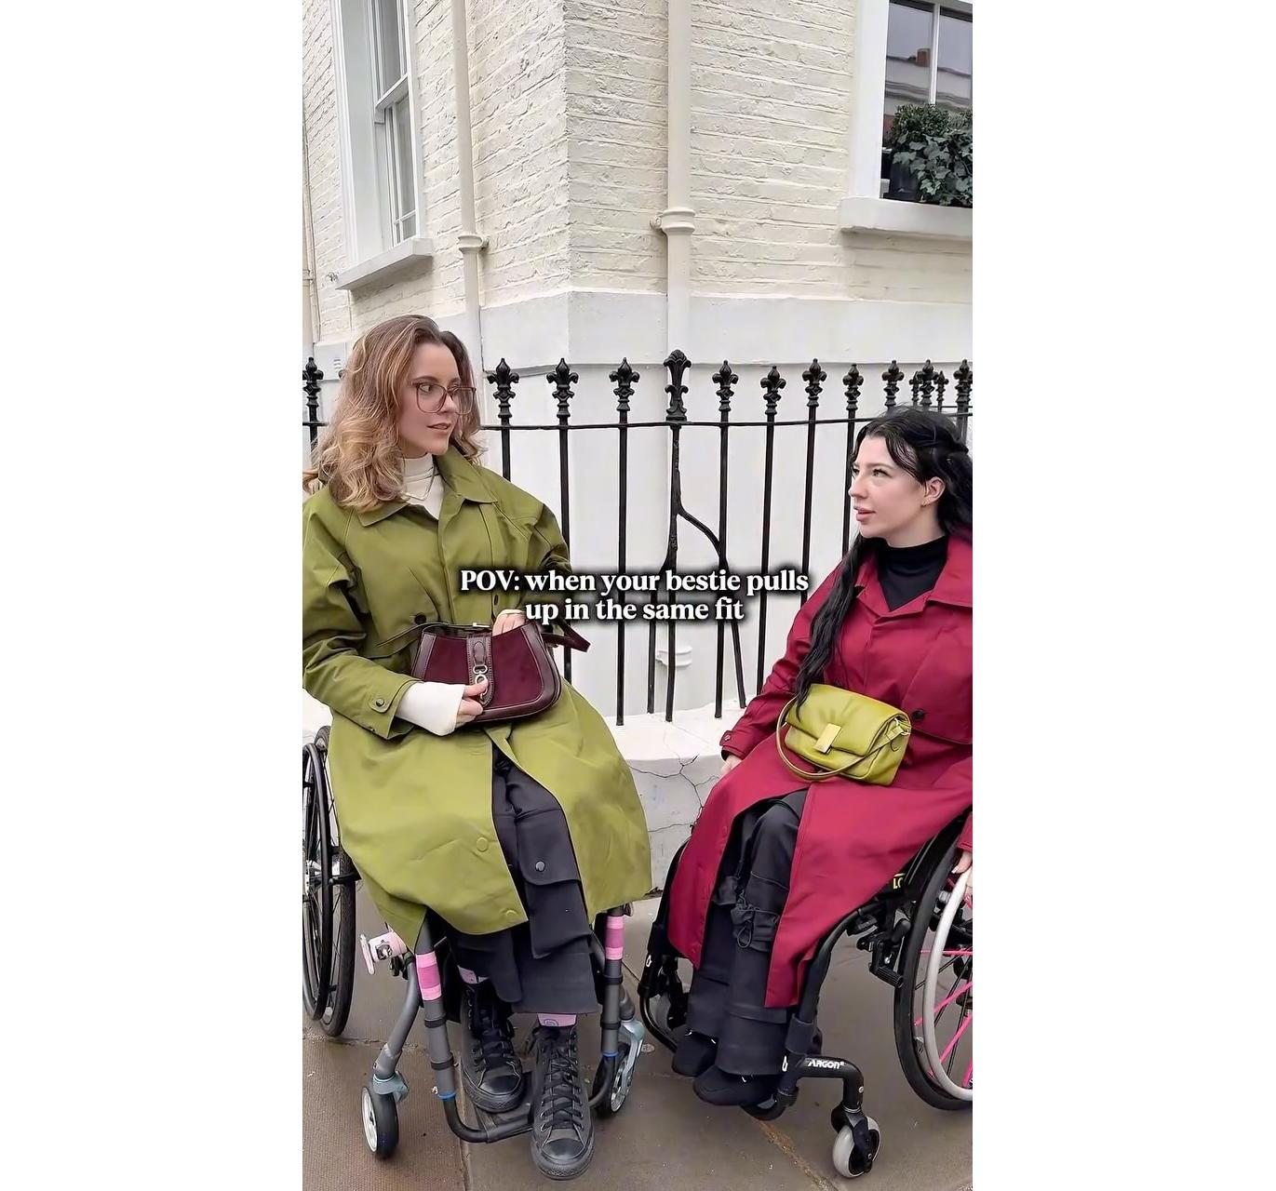
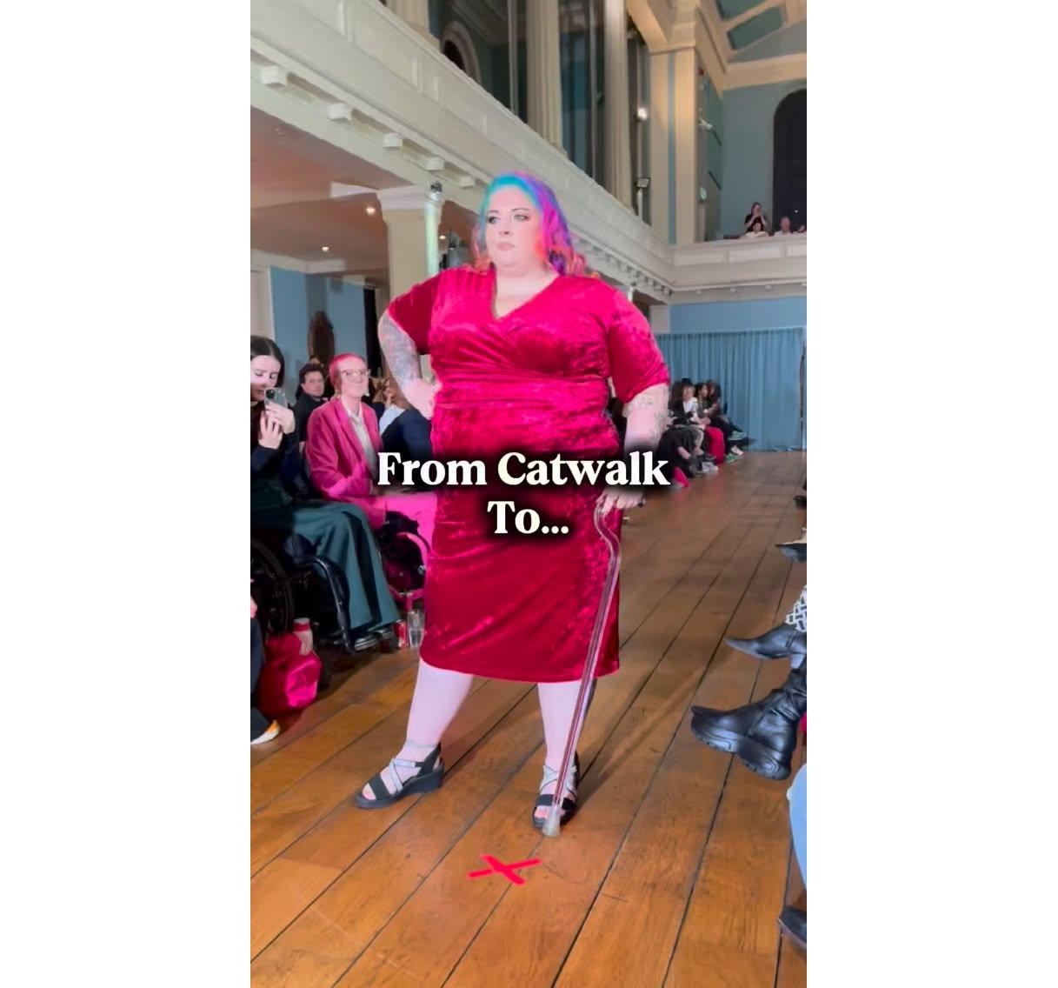
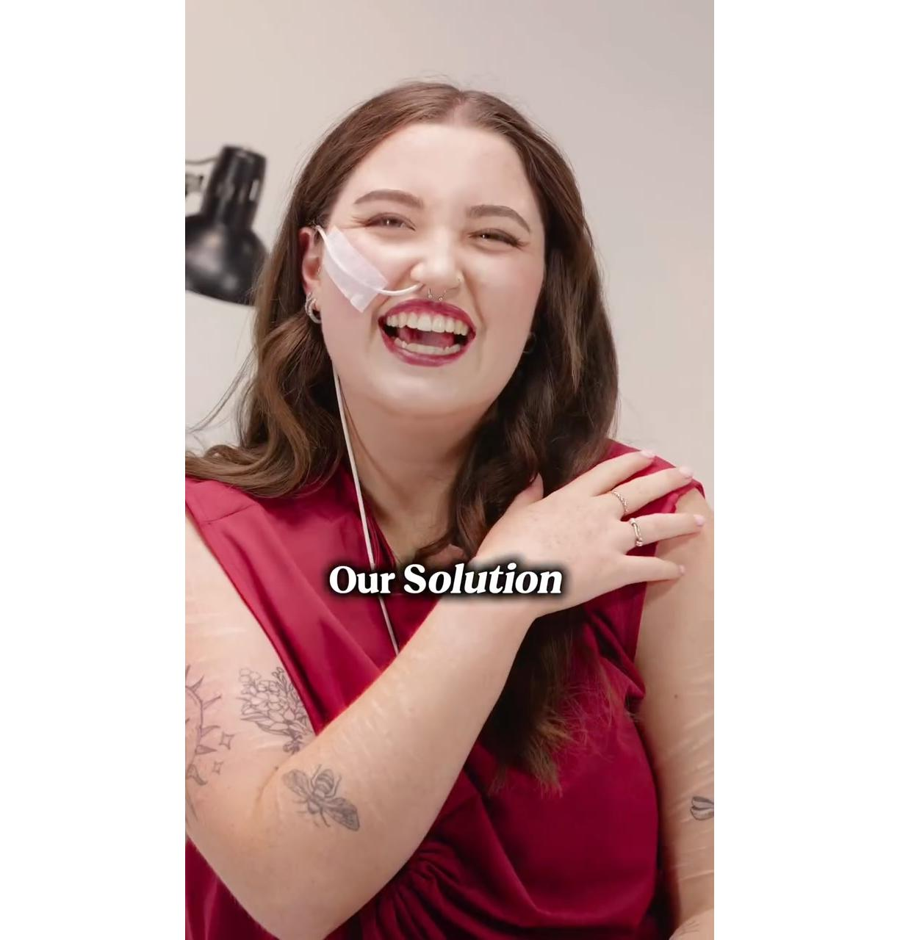
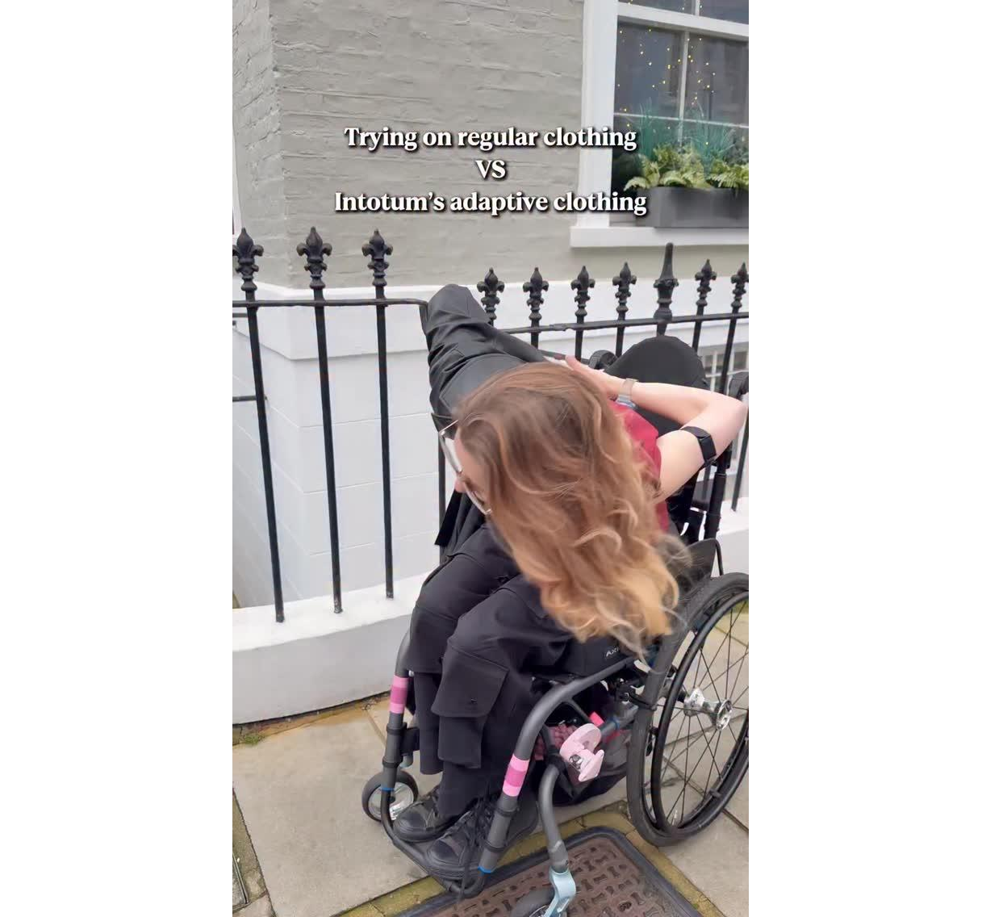
Ranking of reels
intotum_fashion
Showing 20 posts sorted by views
Published |  | Text |  | Views | Reach | Likes | Saved | Comments | Shares | Engagement
Jan 29, 2026 7:03 PM |  | ❌ The problem Getting dressed should not be a dail... | Go | 92.66k | 58.38k | 3118 | 94 | 12 | 42 | 5.59
Jan 21, 2026 7:32 PM |  | Trying on regular clothes vs Intotum adaptive clot... | Go | 46.79k | 29.75k | 700 | 42 | 5 | 21 | 2.58
Jan 25, 2026 6:19 PM |  | It’s the details that count 🥰 #intotum #adaptive... | Go | 45.55k | 30.47k | 682 | 60 | 8 | 38 | 2.59
Jan 26, 2026 8:13 PM |  | Serena & Blair vibes only 🫶 Tag below who you wo... | Go | 18.55k | 11.63k | 236 | 2 | 3 | 4 | 2.11
Jan 22, 2026 8:00 PM |  | Should’ve texted the group chat 👀 Tag the friend... | Go | 15.79k | 9800 | 273 | 5 | 3 | 3 | 2.9
Jan 12, 2026 6:39 PM |  | Off the runway and into real life with this stunni... | Go | 14.39k | 8457 | 340 | 4 | 8 | 8 | 4.26
01 Jan 26
31 Jan 26
-

Slide 23








Published |  | Text |  | Views | Reach | Likes | Saved | Comments | Shares | Engagement
Jan 2, 2026 6:15 PM |  | Come with us to our accessible content day in Nott... | Go | 11.3k | 8488 | 227 | 14 | 20 | 6 | 3.15
Jan 10, 2026 6:38 PM |  | That doesn’t mean just adding zips or lazy designs... | Go | 10.59k | 7006 | 329 | 14 | 12 | 10 | 5.21
Jan 4, 2026 6:48 PM |  | New Year. Same Mission. Stylish adaptive clothing... | Go | 6461 | 4399 | 255 | 7 | 3 | 10 | 6.25
Jan 20, 2026 7:49 PM |  | When the fit is so good that you and your bestie n... | Go | 6305 | 4588 | 108 | 6 | 0 | 10 | 2.7
Jan 8, 2026 6:59 PM |  | I’ve got my girls and we feel so good in our fits ... | Go | 5764 | 3996 | 148 | 5 | 6 | 5 | 4.1
Jan 11, 2026 8:35 PM |  | Our “genius” trousers are not only the comfiest tr... | Go | 5490 | 4374 | 252 | 27 | 8 | 19 | 7
Jan 6, 2026 7:30 PM |  | Our pieces are made to work with your body, but al... | Go | 5484 | 3444 | 131 | 2 | 4 | 4 | 4.09
Jan 23, 2026 7:32 PM |  | Girlhood means designing clothes for everyone. Fun... | Go | 5115 | 3642 | 192 | 2 | 3 | 6 | 5.57
01 Jan 26
31 Jan 26
-

Slide 24






Published |  | Text |  | Views | Reach | Likes | Saved | Comments | Shares | Engagement
Jan 7, 2026 6:11 PM |  | Besties understand 👯‍♀️ Tag your outfit twin 🫶 ... | Go | 4870 | 3299 | 58 | 2 | 0 | 1 | 1.85
Jan 13, 2026 8:38 PM |  | We hit the streets to ask if anyone had heard of I... | Go | 4697 | 3702 | 95 | 4 | 2 | 5 | 2.86
Jan 14, 2026 7:05 PM |  | Her reaction said it all 💛 She finally got to try... | Go | 4568 | 3499 | 149 | 9 | 1 | 8 | 4.77
Jan 30, 2026 7:32 PM |  | Can finally share the news! 😮 Becoming a member ... | Go | 4253 | 2971 | 247 | 6 | 81 | 3 | 11.34
Jan 28, 2026 9:35 PM |  | It should never be a choice between comfort and st... | Go | 4005 | 2474 | 92 | 5 | 4 | 3 | 4.2
Jan 9, 2026 6:29 PM |  | A quick fire Q&A with the gorgeous @feyas_world in... | Go | 3847 | 3063 | 82 | 5 | 7 | 2 | 3.13
01 Jan 26
31 Jan 26
-

Slide 25



Community growth
Intotum
11.10K
26
+73.33%
0
0
Followers
Posts
Acquired
Lost
01 Jan 26
31 Jan 26
-

Slide 26


Account
Intotum
2066
-34.25%
26
+73.33%
Profile views
Posts
01 Jan 26
31 Jan 26
-

Slide 27


Posts viewed in period
Intotum
120.43K
-57.87%
10.72K
-61.70%
107
+40.79%
182
-36.81%
Video views
Likes
Comments
Shares
01 Jan 26
31 Jan 26
-

Slide 28

Demographics: gender and countries
Intotum
Gender
Top 10 countries
United Kingdom | 27.41%
United States | 26.61%
OTHERS | 24.91%
Canada | 4.80%
Australia | 3.49%
Germany | 3.00%
France | 2.69%
Brazil | 1.90%
Netherlands | 1.90%
Ireland | 1.79%
01 Jan 26
31 Jan 26
-

Slide 29


Posts published in period
Intotum
7.23
-46.88%
26
+73.33%
Engagement
Posts
01 Jan 26
31 Jan 26
-

Slide 30


Reach of published posts
Intotum
1669.12
-66.68%
26
+73.33%
Avg reach per post
Posts
01 Jan 26
31 Jan 26
-

Slide 31


Views of published posts
Intotum
50.11K
-40.49%
26
+73.33%
Views
Posts
01 Jan 26
31 Jan 26
-

Slide 32


Interactions of published posts
Intotum
3136
-69.32%
3015
-68.25%
81
-69.08%
40
-91.38%
Interactions
Likes
Comments
Shares
26
+73.33%
Posts
01 Jan 26
31 Jan 26
-

Slide 33


Ranking of posts
Intotum
Showing 20 posts sorted by views
Published |  | Type | Text |  | Views | Likes | Comments | Shares | Reach | Duration | Engagement
Jan 21, 2026 8:36 PM |  |  | Trying on regular clothes vs Intotum adaptive clot... | Go | 7830 | 255 | 2 | 0 | 6985 | 14s | -
Jan 12, 2026 7:40 PM |  |  | Off the runway and into real life with this stunni... | Go | 7010 | 230 | 5 | 3 | 6337 | 7s | -
Jan 29, 2026 8:04 PM |  |  | ❌ The problem Getting dressed should not be a dail... | Go | 5605 | 460 | 0 | 4 | 4137 | 11s | -
Jan 6, 2026 8:32 PM |  |  | Our pieces are made to work with your body, but al... | Go | 2986 | 100 | 2 | 0 | 2776 | 5s | -
Jan 25, 2026 7:33 PM |  |  | It’s the details that count 🥰 #intotum #adaptivef... | Go | 2950 | 187 | 4 | 1 | 2301 | 9s | -
Jan 8, 2026 8:03 PM |  |  | I’ve got my girls and we feel so good in our fits ... | Go | 2815 | 186 | 3 | 4 | 2479 | 7s | -
01 Jan 26
31 Jan 26
-

Slide 34



Published |  | Type | Text |  | Views | Likes | Comments | Shares | Reach | Duration | Engagement
Jan 11, 2026 9:41 PM |  |  | Replying to @lenore 🥩 Our “genius” trousers are n... | Go | 2353 | 279 | 9 | 14 | 2047 | 43s | -
Jan 26, 2026 9:14 PM |  |  | Serena & Blair vibes only 🫶 Tag below who you wou... | Go | 2162 | 146 | 3 | 2 | 1954 | 6s | -
Jan 10, 2026 7:43 PM |  |  | That doesn’t mean just adding zips or lazy designs... | Go | 2075 | 182 | 2 | 3 | 1864 | 7s | -
Jan 4, 2026 8:17 PM |  |  | New Year. Same Mission. Stylish adaptive clothing ... | Go | 1850 | 176 | 4 | 1 | 1675 | 7s | -
Jan 28, 2026 10:39 PM |  |  | It should never be a choice between comfort and st... | Go | 1267 | 106 | 3 | 0 | 1121 | 7s | -
Jan 7, 2026 7:10 PM |  |  | Besties understand 👯‍♀️ Tag your outfit twin 🫶 #... | Go | 1086 | 38 | 0 | 0 | 1004 | 6s | -
Jan 30, 2026 8:45 PM |  |  | Can finally share the news! 😮 Becoming a member o... | Go | 1038 | 98 | 26 | 2 | 827 | 40s | -
Jan 2, 2026 7:29 PM |  |  | Come with us to our accessible content day in Nott... | Go | 1020 | 71 | 1 | 0 | 890 | 16s | -
01 Jan 26
31 Jan 26
-

Slide 35


Published |  | Type | Text |  | Views | Likes | Comments | Shares | Reach | Duration | Engagement
Jan 14, 2026 8:07 PM |  |  | Her reaction said it all 💛 She finally got to try... | Go | 995 | 75 | 6 | 2 | 895 | 24s | -
Jan 1, 2026 11:02 PM |  |  | Because this one meant a lot 🤭💛 We spent the day... | Go | 984 | 32 | 0 | 0 | 833 | 0s | -
Jan 5, 2026 9:16 PM |  |  | Let’s break it down with an Intotum FAQs moment 🫶... | Go | 970 | 24 | 2 | 0 | 865 | 0s | -
Jan 27, 2026 8:36 PM |  |  | This little feature carries more than you think 👀... | Go | 849 | 36 | 0 | 0 | 762 | 10s | -
Jan 15, 2026 10:15 PM |  |  | Adaptive design means thinking about comfort, ease... | Go | 799 | 55 | 4 | 0 | 674 | 0s | -
Jan 9, 2026 7:35 PM |  |  | A quick fire Q&A with the gorgeous @feyas_world in... | Go | 771 | 52 | 0 | 1 | 705 | 1m 15s | -
01 Jan 26
31 Jan 26
-

